Slide 1
Production Tests:
Pulsar 2b integrated with PRM (KU040 or KU060)
Lucas, Miqueias, Sudha, Zijun, Zhaoru, Zhen
18/05/2016

Slide 2
Board List and setup
Board List
5 Pulsar2b: 6-1, 6-2, …, 6-5
3 protoPRM with KU040
5 protoPRM with KU060
Setup
Pulsar2b-6-1 with 2 PRM-ku040
Pulsar2b-6-2 with 2 PRM-ku060
Pulsar2b-6-3 with 1 PRM-ku040
Pulsar2b-6-4 with 1 PRM-ku060
Pulsar2b-6-5 with 2 PRM-ku060

Slide 3
Test List
GTH Test with IBERT
Pulsar2b fabric interface with mini-backplane in the 1U crate at 10.0 Gbps
Pulsar2b FMC interface with protoPRM at 10.0 Gbps
protoPRM local channel between master and slave FPGA at 16.375 Gbps for KU060
RTMs at 8.0 Gbps
LVDS Test
Pulsar2b FMC interface with protoPRM at 100MHz
protoPRM local channel between master and slave at 200MHz

Slide 4
Issue List
Pulsar2b-6-5 fabric interface with mini-backplane
GT-X1Y32( Quad118-0) eye is narrow comparing with others
Pulsar2b-6-2 FMC interface with two PRM-ku060
1 GTH line dead in bi-direction in FMC-2
LVDS from PRM to PL2b in FMC-2 has some issue
Maybe just 1 LVDS-pair is broke, not sure
1 GTH line not good from PL2b to PRM in FMC-1
1 GTH line not good from PL2b to PRM in FMC-3

Slide 5
Details

Slide 6
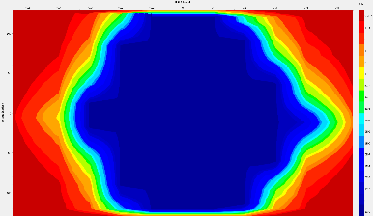
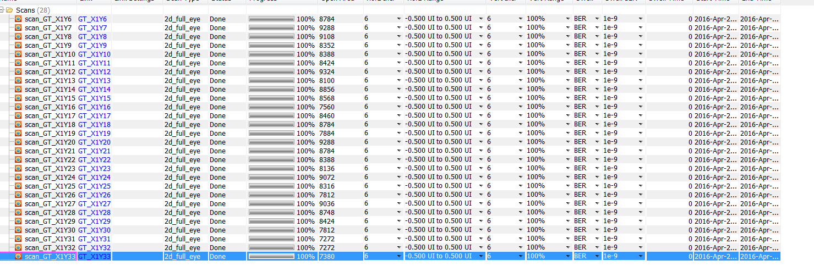
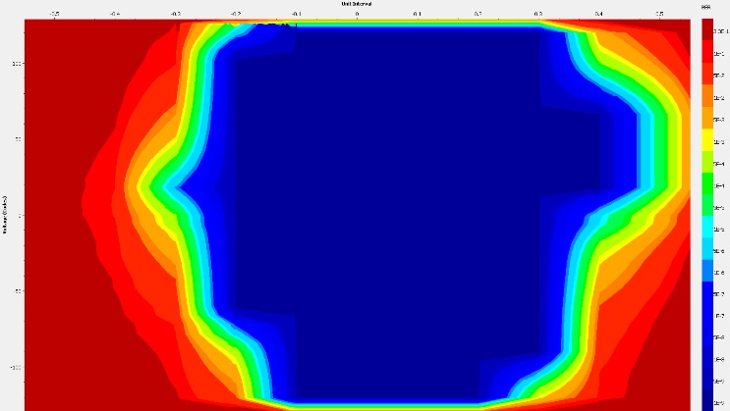
Pulsar2b 6-1 + (2)PRM 4
1U crate
Tested at 10.0 Gb/s: BER<1e-14
Tested the Pulsar FMC with PRM (GTH channels). All channels are error free. Pulsar2b assigns 3 GTH to each FMC, while protoPRM has 4 available.
Tested the fabric interface
Tested the LVDS for each FMC connector between Pulsar2b FPGA and protoPRM Master FPGA
Fabric with minibackplane

Slide 7
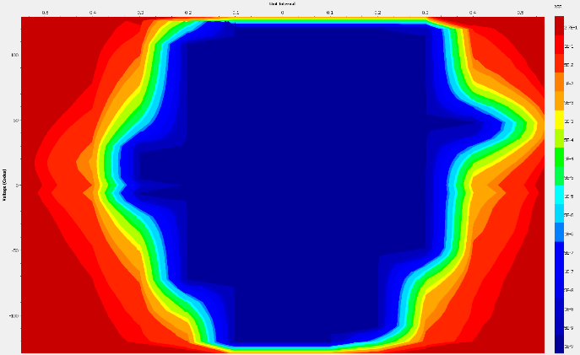
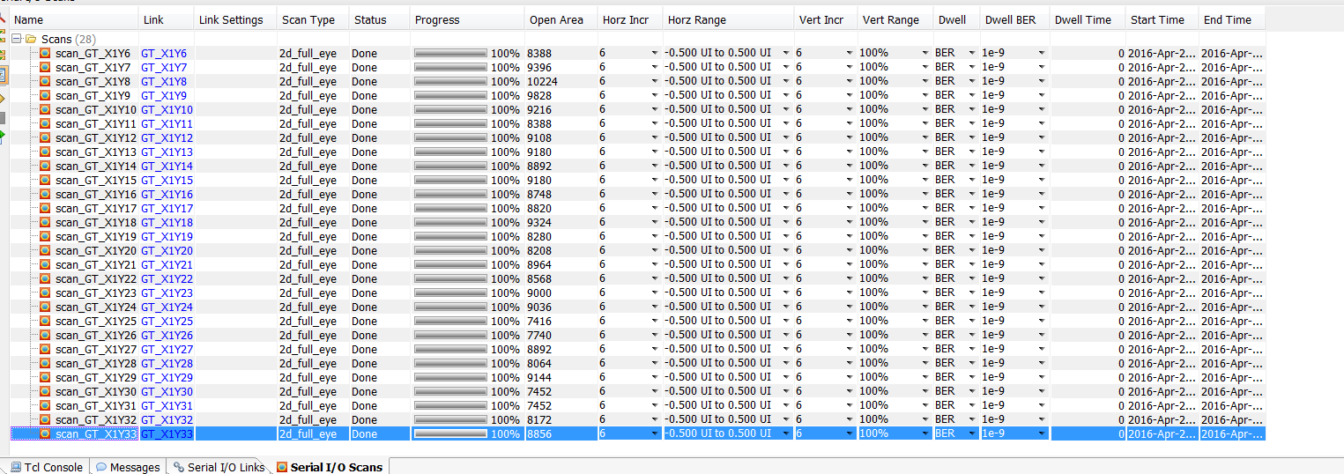
Pulsar2b 6-2 + (2)PRM 6
1U crate
Tested at 10.0 Gb/s: BER<1e-14
Tested the Pulsar FMC with PRM (GTH channels). All channels are error free. Pulsar2b assigns 3 GTH to each FMC, while protoPRM has 4 available.
Tested the fabric interface
Tested the LVDS for each FMC connector between Pulsar2b FPGA and protoPRM Master FPGA
Fabric with minibackplane

Slide 8
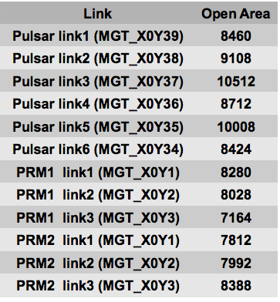
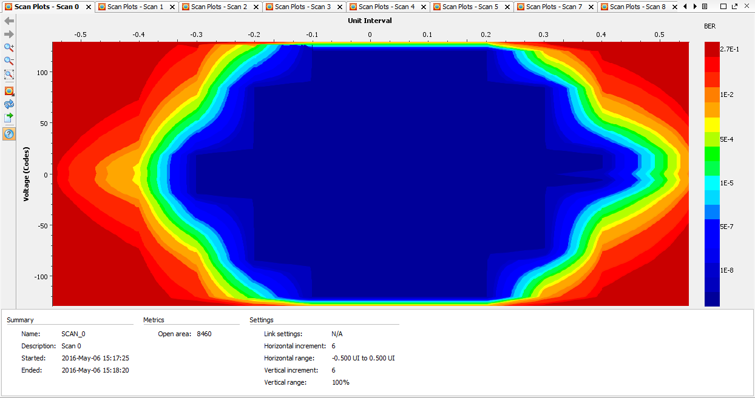
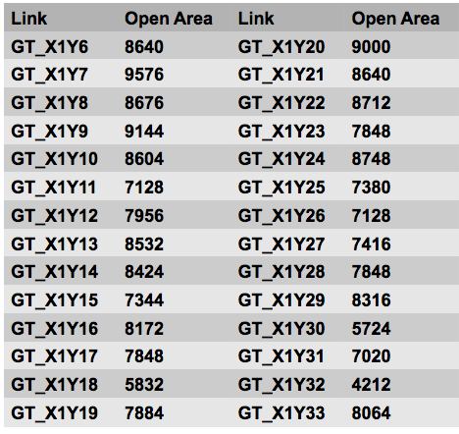
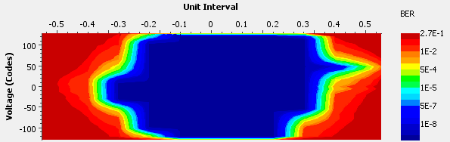
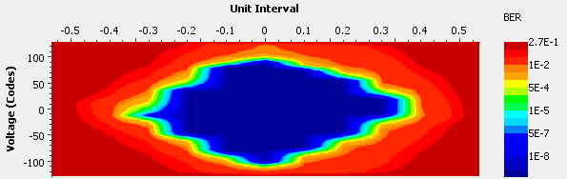
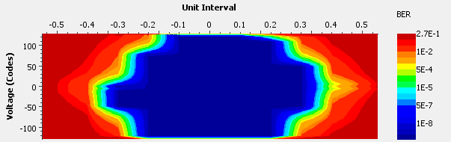
Pulsar2b 6-3 + (1)PRM 4-1
1U crate
Tested at 10.0 Gb/s: BER<1e-14
Tested the Pulsar FMC with PRM (GTH channels). All channels are error free. Pulsar2b assigns 3 GTH to each FMC, while protoPRM has 4 available.
Tested the fabric interface
Tested the LVDS for each FMC connector between Pulsar2b FPGA and protoPRM Master FPGA

Slide 9
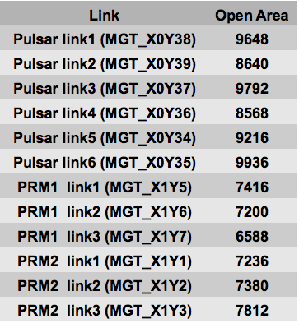
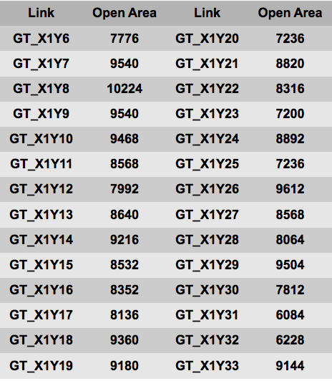
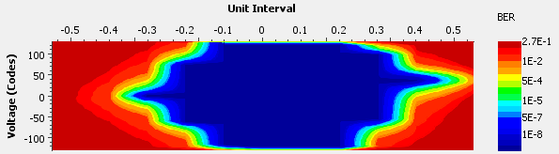
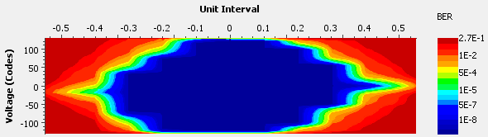
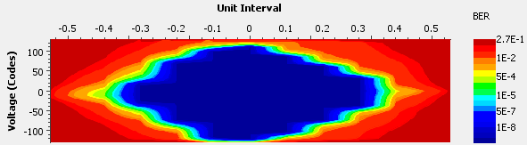
Pulsar2b 6-4 + (1)PRM 6-4
1U crate
Tested at 10.0 Gb/s: BER<1e-14
Tested the Pulsar FMC with PRM (GTH channels). All channels are error free. Pulsar2b assigns 3 GTH to each FMC, while protoPRM has 4 available.
Tested the fabric interface
Tested the LVDS for each FMC connector between Pulsar2b FPGA and protoPRM Master FPGA

Slide 10
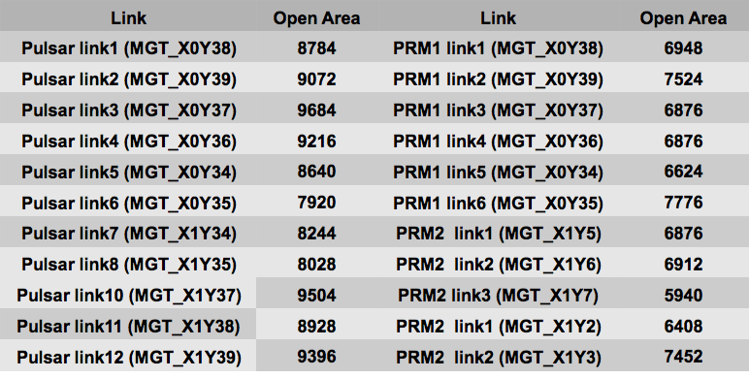
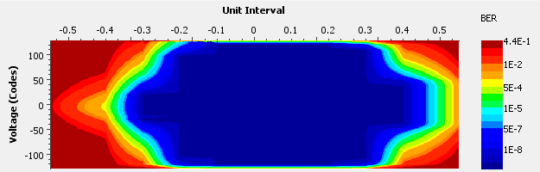
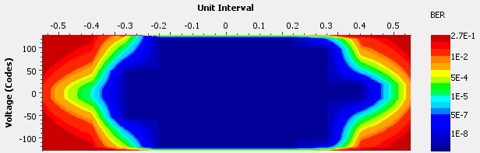
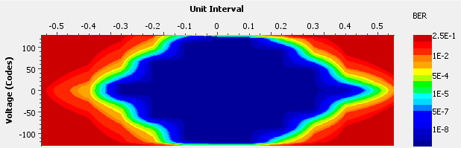
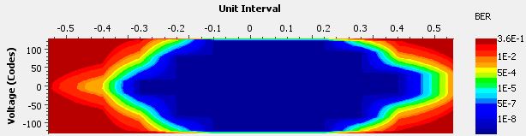
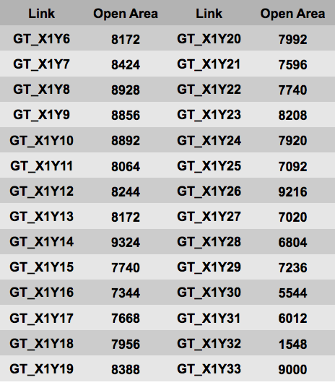
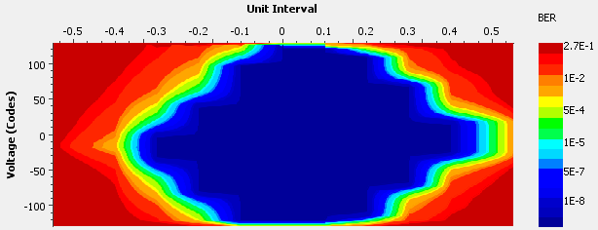
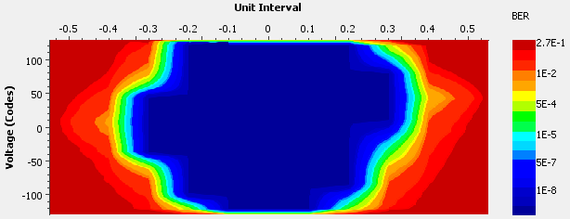
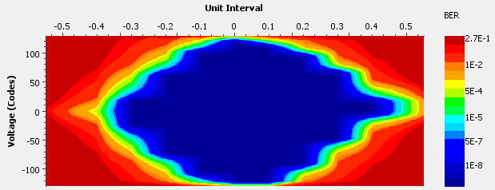
Pulsar2b 6-5 + (2)PRM 60
1U crate
Tested at 10.0 Gb/s: BER<1e-14
Tested the Pulsar FMC with PRM (GTH channels). All channels are error free. Pulsar2b assigns 3 GTH to each FMC, while protoPRM has 4 available.
Tested the fabric interface
Tested the LVDS for each FMC connector between Pulsar2b FPGA and protoPRM Master FPGA
Open area too low

Slide 11
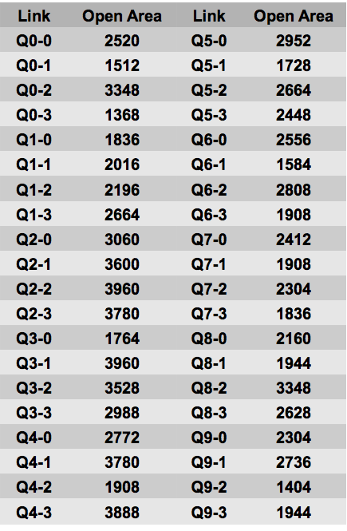
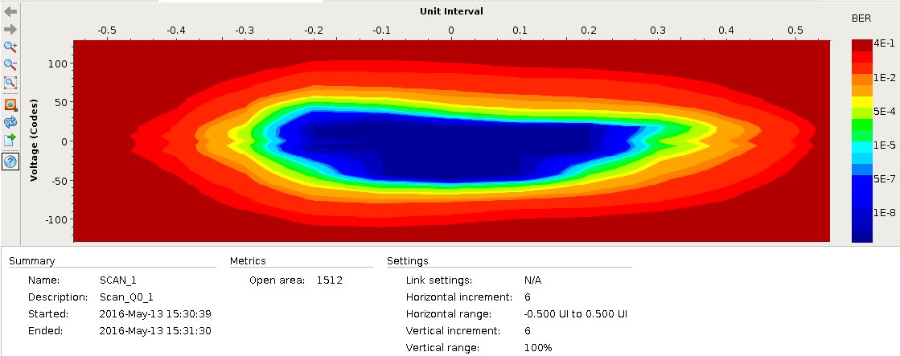
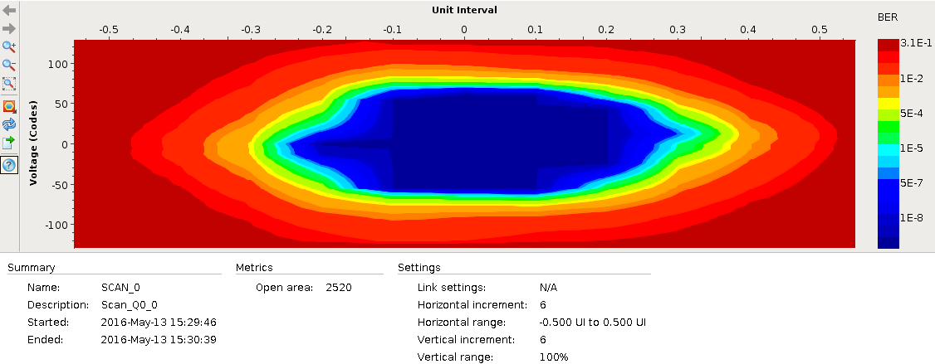
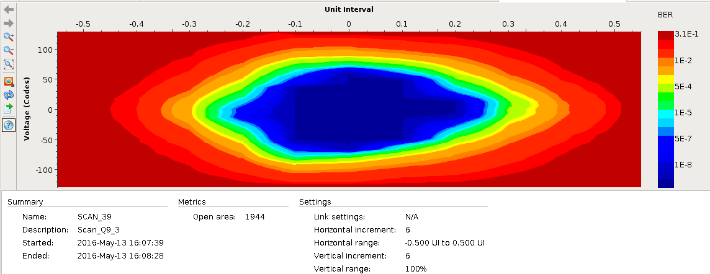
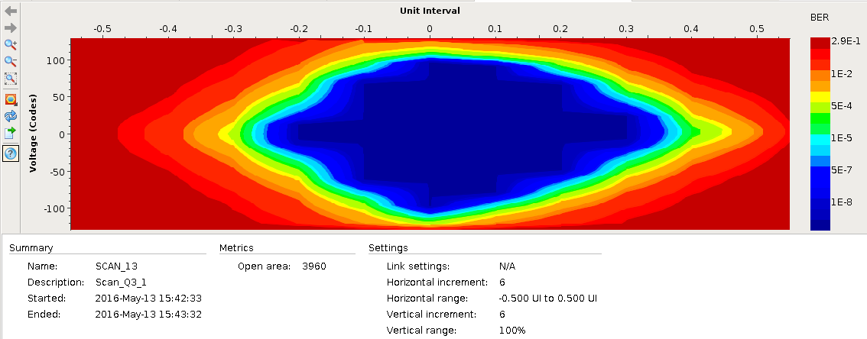
RTM results: Slot 9->12
Tested at 8Gbps
Results look fine
All channels error free

Slide 12
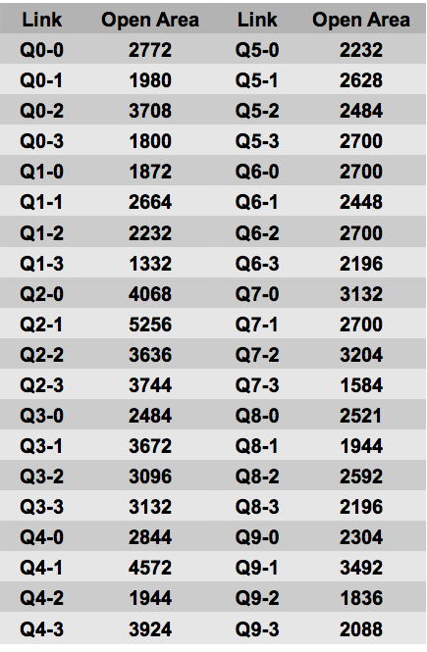
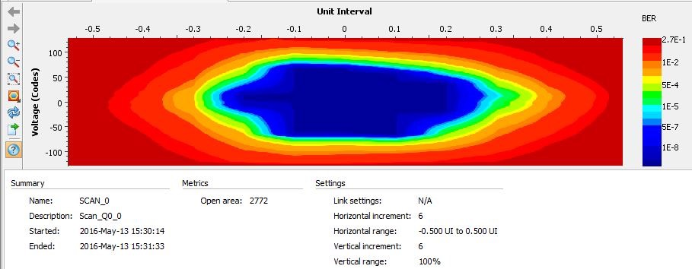
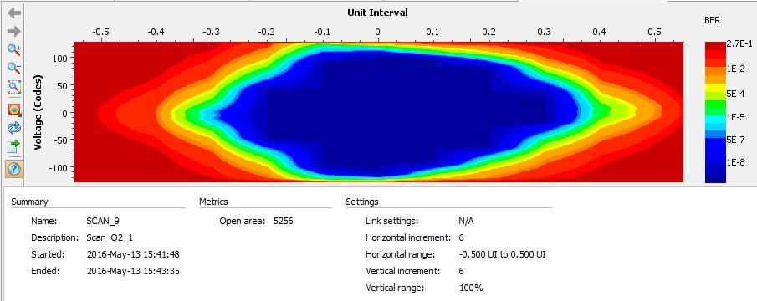
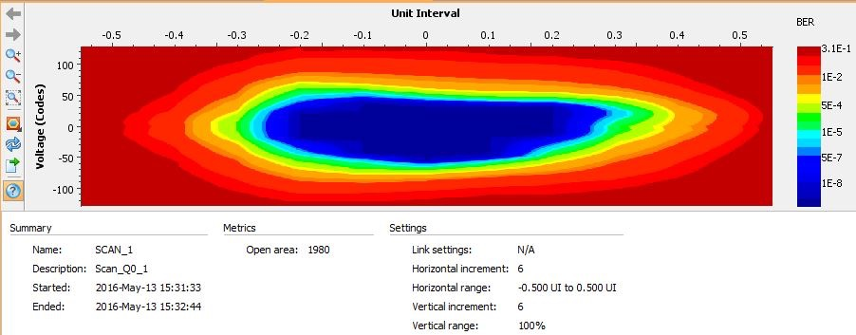
RTM results: Slot 12->9
Tested at 8Gbps
Results look fine
All channels error free

Slide 13
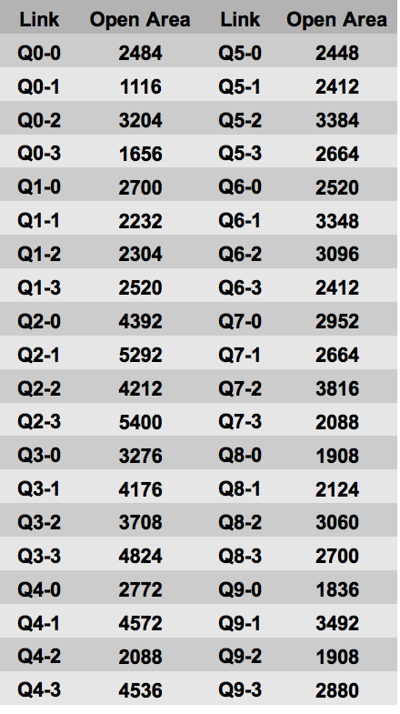
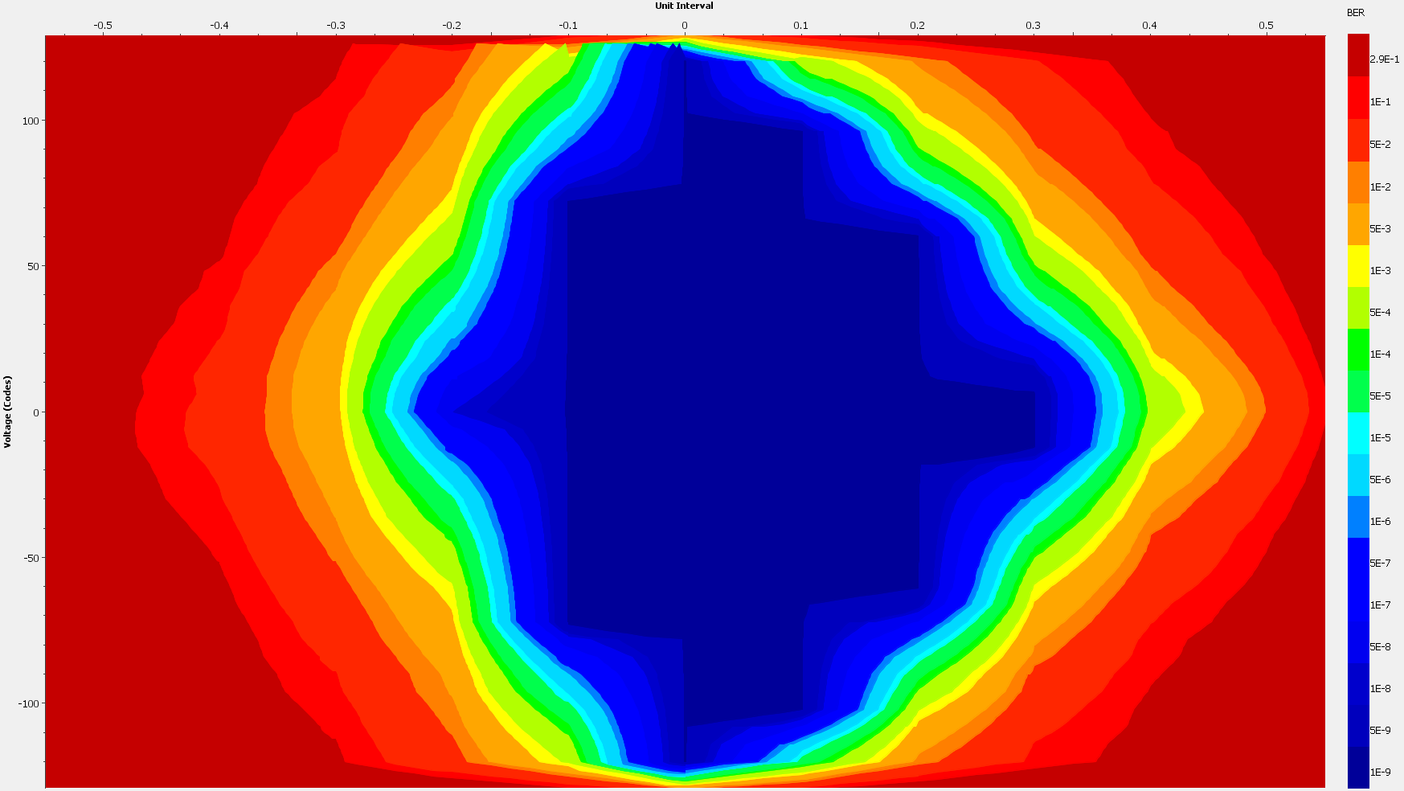
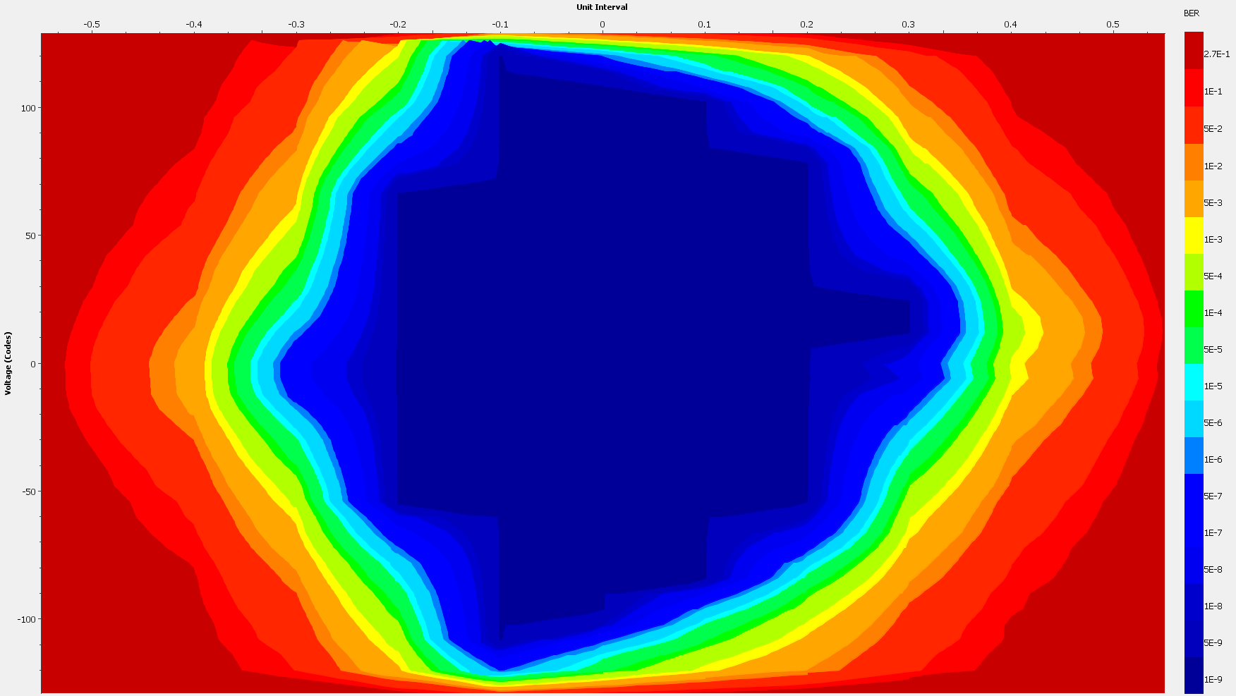
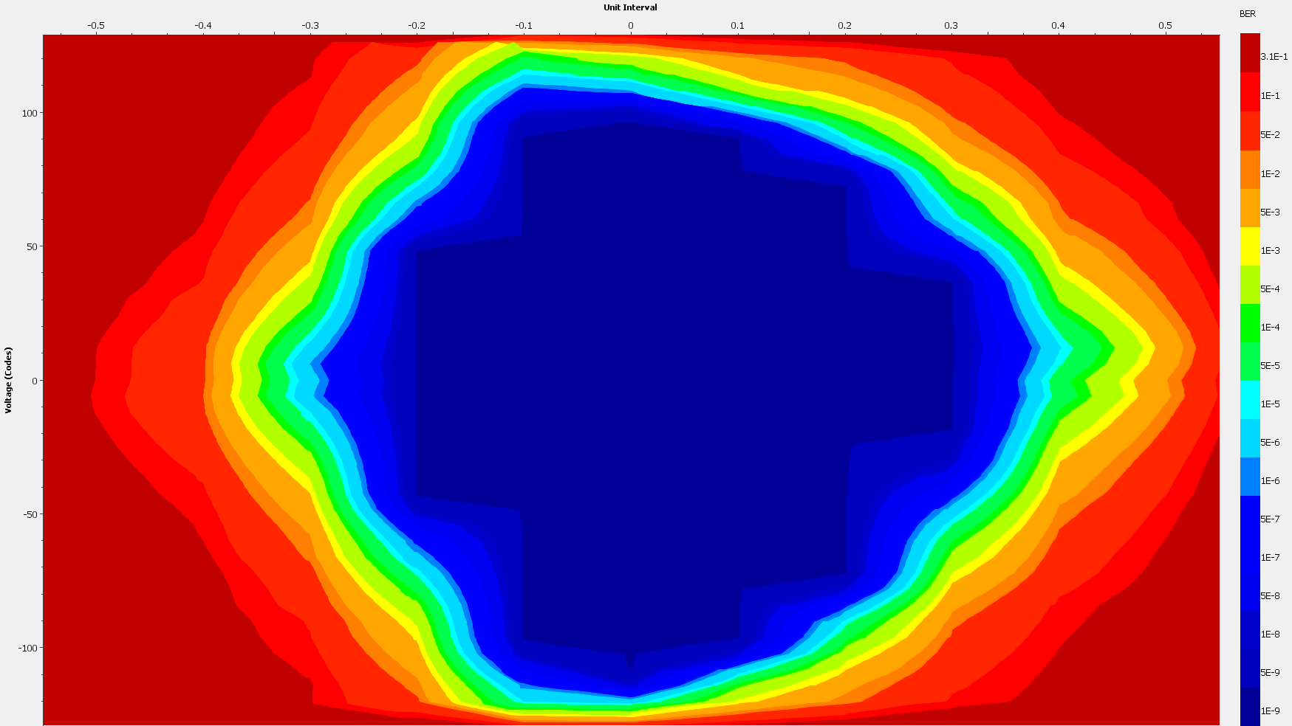
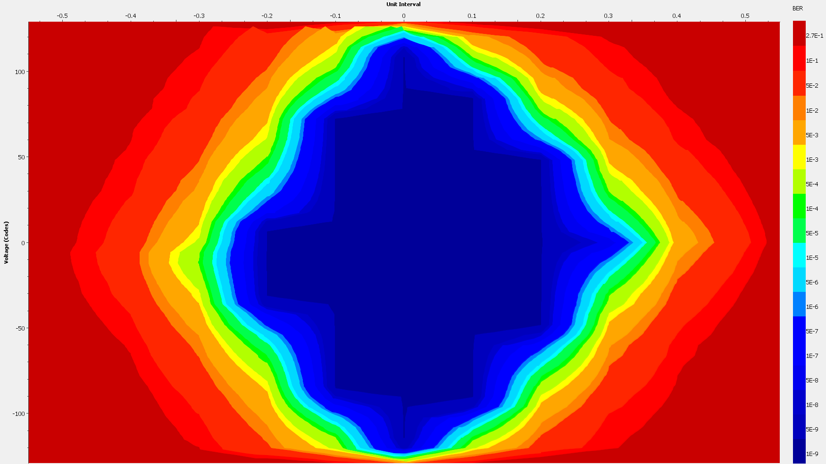
RTM results: Slot 10->11
Tested at 8Gbps
Results look fine
All channels error free

Slide 14
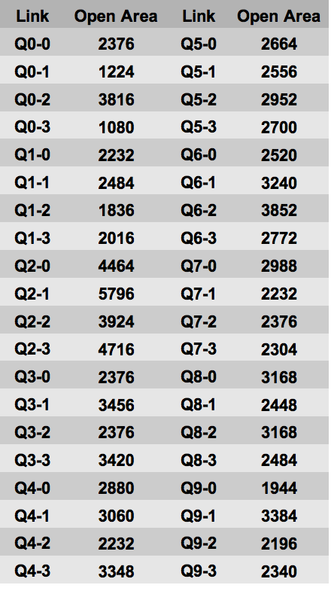
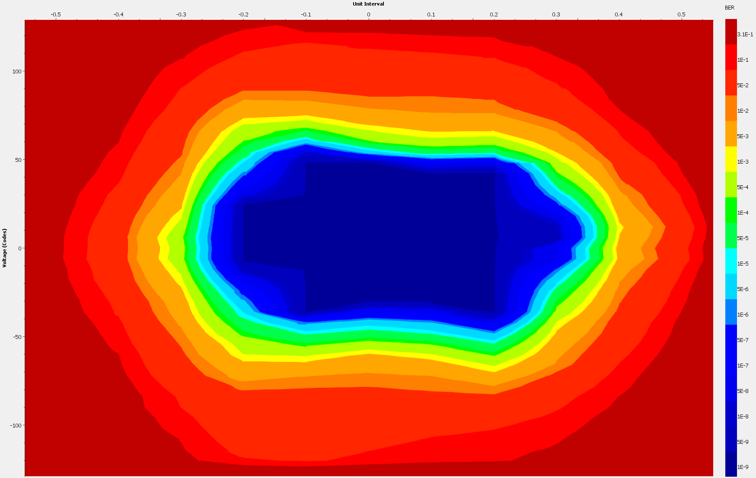
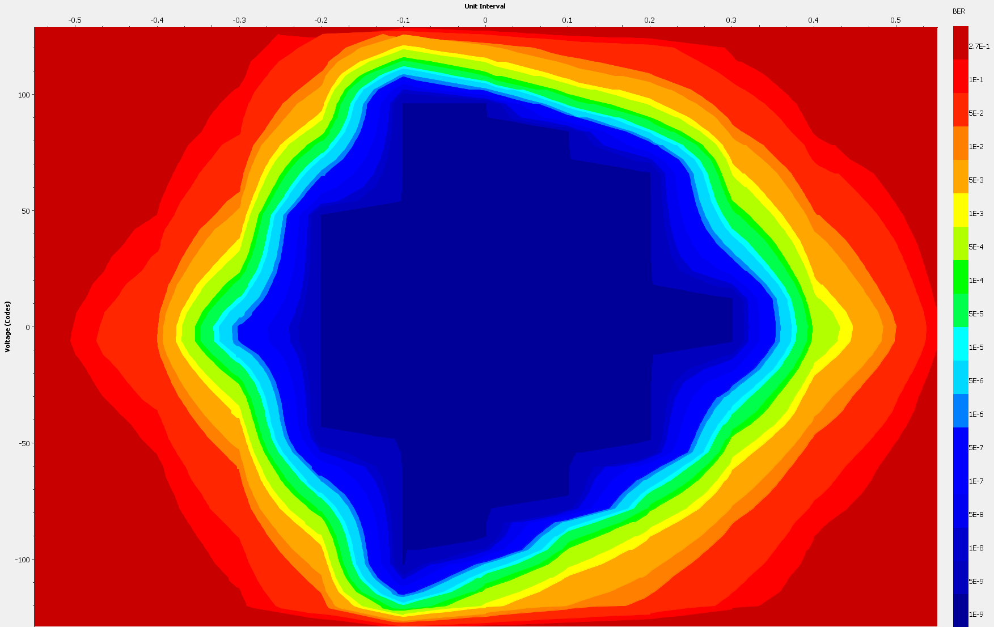
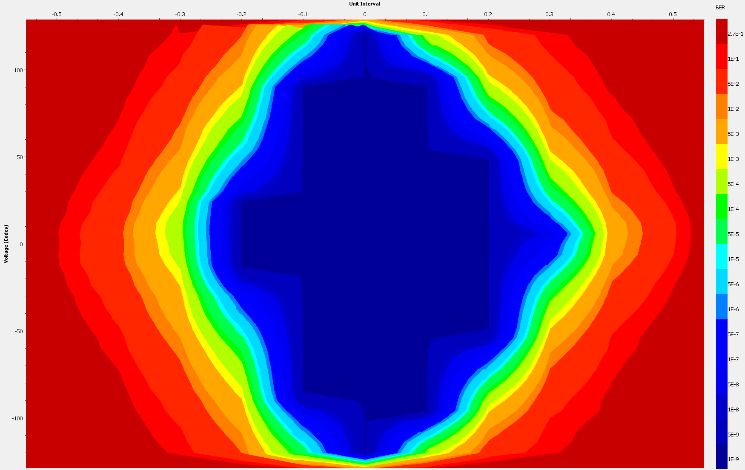
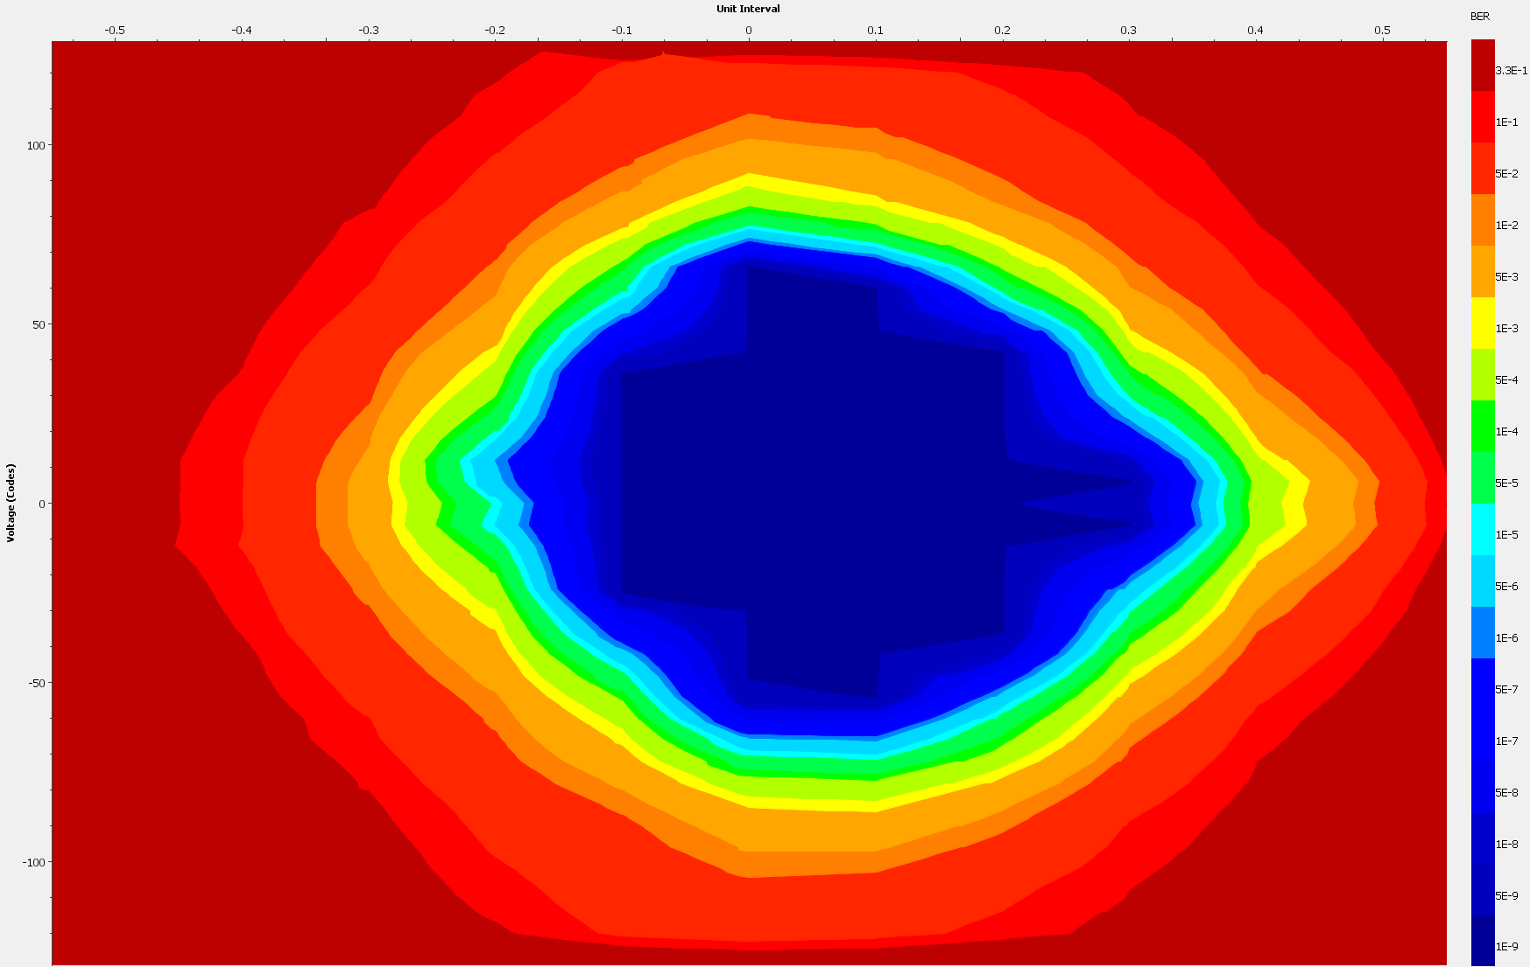
RTM results: Slot 11->10
Tested at 8Gbps
Results look fine
All channels error free

Slide 15
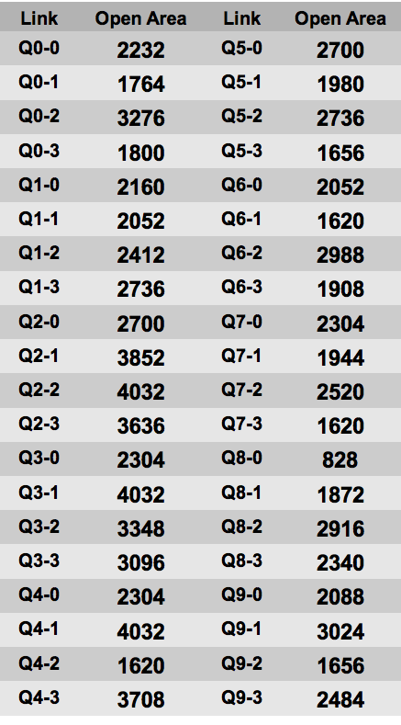
RTM results: Slot 9->13
Tested at 8Gbps
Results look fine
All channels error free

Slide 16
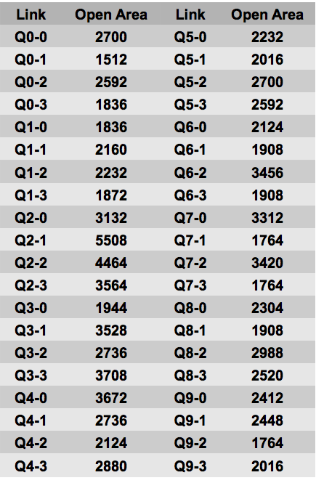
RTM results: Slot 13->9
Tested at 8Gbps
Results look fine
All channels error free

Slide 17
Other issue
Network issue (no clear now)
Some timing delay issues were observed while testing the boards remotely (from different PC’s using wireless connections)

